Slide 1
IMDB movie review

Slide 2
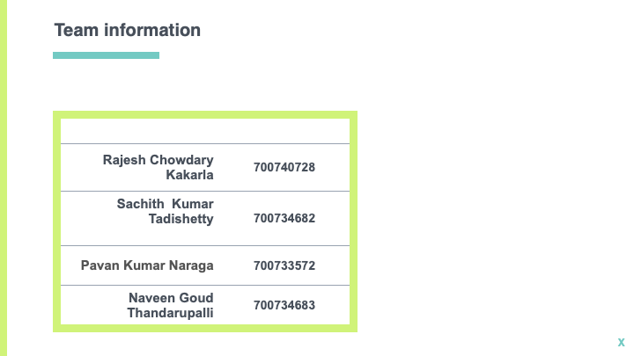
Name1
Name2
Name3
Name4

Slide 3
Roles and responsibilities
Step 1
Data collection
Hardware requirements
Software requirements
Listing the Python dependencies
Step 2
Text preprocessing
Tokenization
Step 3
Bag of words modeling
TFIDF vectorization
Step 4
Implementing machine learning algorithms
Step 5
Scaling the algorithm
Performance analysis
Choosing the best algorithms
Step 6
Saving the models
Step 7
Implementing in web application
Step 8
Uploading the project into github
Creating a project video
Step 9
Creating report

Slide 4
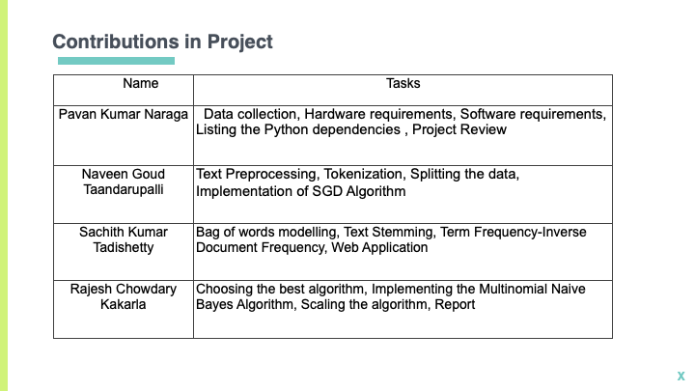

Slide 5
Problem statement
Sentiment analysis is a process of analyzing emotions in the low-level texts chats, reviews etc.,.There are no novel approaches to tackle these problems using non-machine learning techniques.Due to huge data release, the entertainment industry can leverage this opportunity to improve their brand values by analyzing the texts.Though there are techniques that exist in the few industries they are at the research level and they can not handle large amounts of data.

Slide 6
Proposed solution
Sentiment analysis is the current popular method to know the business value in the market by analyzing the user feedback. Sentiment analysis helps the business to know the pulse of the customer and where to improve factors.Using Natural Language Processing(NLP) we can analyze the sentiments underlying the sentences whether positive or negative.Machine learning models are the most sought after methods to tackle problems in this area.

Slide 7
Motivation
With evolution of internet and ecommerce business everything has come to our fingertips either it can be buying the product or reviewing the product. According to the survey in 2017 a buyer read average of 7 reviews of the product before purchasing. The statistics of the previous year shows the number is 6. Nowadays a lot of businesses are looking towards customer satisfaction factors and their opinions. Movie industry is one of them.In our project we have collected the reviews from the Internet Movie Database(IMDB) dataset from kaggle to analyze the sentiments of the reviews.

Slide 8
Objectives
In our project BoW(Bag of Words) and TFIDF vectorizer models are implemented and to classify the given inputs we have used 2 classification algorithms SGD(Stochastic Gradient Descent) and Multinomial Naive Bayes compared the results of both the methods.The objective of the project is to classify the given review into positive or negative using Multinomial Naive Bayes and Stochastic Gradient Descent algorithms.

Slide 9
Related work
Everyday different kinds data is generated from different entities.In that text data is generated from multiple industries and majority of the text data is generated from the following industries e-commerce sites movie databases.This data is used mainly for sentiment analysis putting NLP(Natural Language Processing) to work.Using NLP drawing meaningful insights makes the businesses understand the brand value in the market[1].The text is classified using the 2 best text classification models Multinomial Naive Bayes and Stochastic Gradient Descent algorithms. SGD is an efficient approach for classification tasks that uses the convex loss functions such as (linear) Support Vector Machines and Logistic Regression. SGD can be efficiently applied to large-scale and sparse machine learning problems that can be encountered in text classification and natural language processing[2]. In addition to SGD, Multinomial Naive Bayes algorithms also outperform the traditional algorithms in text classification. Multinomial Naive Bayes algorithm is a probabilistic learning method that is mostly used in Natural Language Processing (NLP). The algorithm is based on the Bayes theorem and predicts the tag of a text such as a piece of email or newspaper article.Multinomial Naive Bayes classifier achieved 73% accuracy on the small text dataset for news classifier where as Bernoulli Naive Bayes classifier achieved 69% accuracy on the same dataset[3].

Slide 10
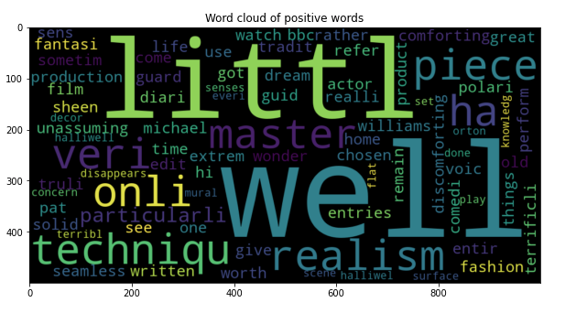
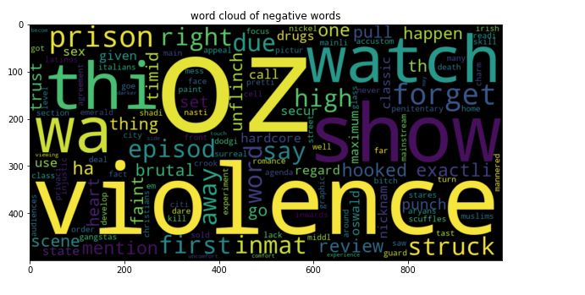
Results

Slide 11
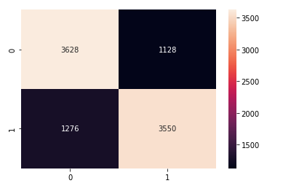
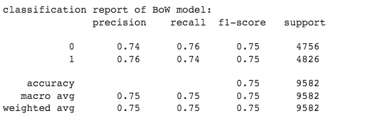
Results
Multinomial Naive Bayes algorithm is a probabilistic learning method that is mostly used in Natural Language Processing (NLP). The algorithm is based on the Bayes theorem and predicts the tag of a text such as a piece of email or newspaper article. Above figures show classification report and confusion matrix for Multinomial Naive Bayes using BoW(Bag of Words) method.It achieved 75% accuracy on test data.

Slide 12
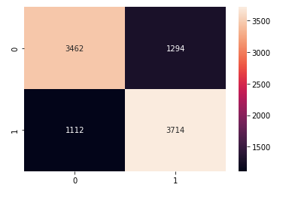
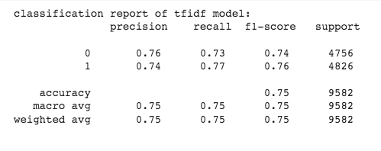
Results
Above figures show classification report and confusion matrix for Multinomial Naive Bayes using TF IDF(Term Frequency-Inverse Document Frequency )method. It achieved 75% accuracy on test data.

Slide 13
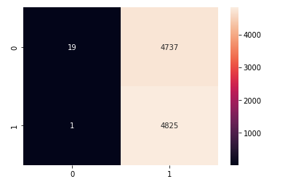
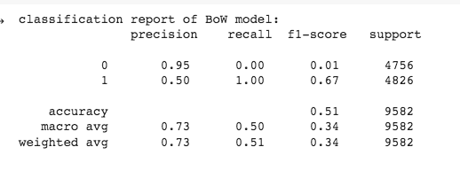
Results
SGD is an efficient approach to fitting linear classifiers and regressors under convex loss functions such as (linear) Support Vector Machines and Logistic Regression.Above figures show classification report and confusion matrix for Stochastic Gradient Descent(SGD)using BoW(Bag of Words)method.It achieved 51%accuracy on test data.

Slide 14
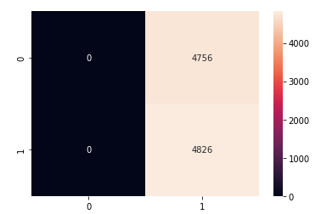
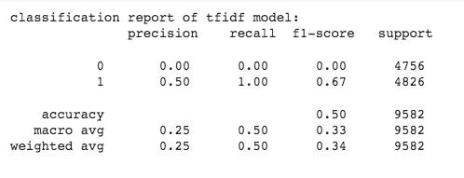
Results
Above figures show classification report and confusion matrix for Stochastic Gradient Descent(SGD) using TF IDF(Term Frequency-Inverse Document Frequency )method.It achieved 50% accuracy on test data.

Slide 15
Results summary
Upon conducting the experimental analysis with Bag of Words and TF IDF methods with machine learning models SGD and Multinomial Naive Bayes. Multinomial Naive bayes algorithm performed well compared to the SGD. If we analyse the performance BoW and TF IDF methods wise both the methods gave similar results.

Slide 16
References
[1].S. Tripathi, R. Mehrotra, V. Bansal and S. Upadhyay, "Analyzing Sentiment using IMDb Dataset," 2020 12th International Conference on Computational Intelligence and Communication Networks (CICN), 2020, pp. 30-33, doi: 10.1109/CICN49253.2020.9242570.
[2]A. Thudi, G. Deza, V. Chandrasekaran and N. Papernot, "Unrolling SGD: Understanding Factors Influencing Machine Unlearning," 2022 IEEE 7th European Symposium on Security and Privacy (EuroS&P), 2022, pp. 303-319, doi: 10.1109/EuroSP53844.2022.00027.
[3].G. Singh, B. Kumar, L. Gaur and A. Tyagi, "Comparison between Multinomial and Bernoulli Naïve Bayes for Text Classification," 2019 International Conference on Automation, Computational and Technology Management (ICACTM), 2019, pp. 593-596, doi: 10.1109/ICACTM.2019.8776800.

Slide 17
Thanks!
Any questions?

